Slide 1
Mines, Minerals, and Minecraft
Dr. Charles “Chuck” Bell
Lesson 8: 20 March 2019

Slide 2
Decision Time
How many more classes do you want?
Originally planned 10 (2 more left)
Some can no longer attend Wednesday
So, do we meet one or two more times?

Slide 3
Agenda
Bible Study: 10-15 minutes
The Raspberry Pi: 5-10 minutes
Hacking Minecraft with Python: 30-45 minutes
Lab Time: Games in Minecraft

Slide 4
Bible Study
Water Sources in the Bible

Slide 5
What is Water?
Made up of 3 atoms
(2) hydrogen, (1) oxygen
Found in 3 forms
Solid, liquid and gas
Tasteless, odorless and mostly colorless
Water has a slightly blue hue to it, and is responsible for our planet’s blue color from space
Atomic structure causes strong attractive forces between molecules
Giving it high surface tension
Ability to “climb” within a tube (trees, etc.)
Referred to as the “universal solvent”
Critical to all life forms
All of the components in cells (proteins, DNA and polysaccharides) are dissolved in water, deriving their structure and activity from their interactions with the water.
H₂O

Slide 6
What is a well?
Well [S](Heb. beer), to be distinguished from a fountain (Heb. 'ain). A "beer" was a deep shaft, bored far under the rocky surface by the art of man, which contained water which percolated through the strata in its sides.
Such wells were those of Jacob and Beersheba, etc. (see Genesis 21:19 Genesis 21:25 Genesis 21:30 Genesis 21:31 ; 24:11 ; Genesis 26:15 Genesis 26:18-25 Genesis 26:32 , etc.).
In the Pentateuch this word beer, so rendered, occurs twenty-five times.

Slide 7
Water Sources in the Bible
For reasons of climate in ancient Israel (very dry ‘arid’), references to water wells in the Bible are numerous and significant.
Sources
River water
Springs
Cisterns
Wells

Slide 8
River Water
The River Litani and the River Jordan are the only rivers of any size in the vicinity of the land of Canaan.
Perennial brooks are very scarce and the wadis, or streambeds, while numerous and impetuous in the rainy season, are dry during the rest of the year.
Job 6:16-17 compares faithless friends to these torrent-beds, swollen in the spring, but vanishing in the hot weather.
Ben Sira twice enumerates water as the first among the "principal things necessary for the life of man."

Slide 9
Springs
A spring is the "eye of the landscape", the natural burst of living water, flowing all year or drying up at certain seasons.
In contrast to the "troubled waters" of wells and rivers (Jer. 2:18), there gushes forth from it "living water", to which Jesus compared the grace of the Holy Spirit (John 4:10; 7:38; compare Isaiah 12:3; 44:3).
Towns and hamlets bear names compounded with the word Ain (En), Hebrew for a well or spring. For example, Endor (spring of Dor), Engannin (spring of gardens), Engaddi (spring of the kid), Rogel or En-rogel (spring of the foot), Ensemes (spring of the sun), etc.
However, springs were comparatively rare; biblical language distinguishes the natural springs from the wells, which are water pits bored under the rocky surface and having no outlet. They belonged to and were named by the person who dug them.
Many names of places, too, are compounded with B'er (the Hebrew word "well"), such as Bersable, Beroth, Beer Elim, etc.

Slide 10
Cisterns
Cisterns are subterranean reservoirs, sometimes covering as much as an acre of land, in which the rainwater is gathered during the spring.
Jerusalem was so well supplied with them that in all the sieges no one within its walls ever suffered from want of water.
Cisterns were hewed into the native rock and then lined with impervious masonry and cement.
The mouth of wells and cisterns was generally surrounded by a curb or low wall and closed with a stone, both to prevent accidents and to keep away strangers. If the owner neglected to cover the cistern, and a domestic animal fell into it, the Mosaic law obliged him to pay the price of the animal (Exodus 21:33-34; compare Luke 14:5).
Sometimes the stone placed on the orifice was so heavy that one man was unable to remove it (Genesis 29:3).
When dry, cisterns were used as dungeons, because, narrowed at the top, like "huge bottles", they left no avenue open for escape (Genesis 37:24; Jeremiah 38:6; 1 Maccabees 7:19). They also offered convenient places for hiding a person from his pursuers (1 Kings 13:6; 2 Kings 17:18).

Slide 11
Wells
Wells were dug by hand and often were the only source of water for a great distance.
They were generally shared and like cisterns, named after the owner.
Beerlahairoi
Beersheba
Wells were also closely guarded because an enemy might reduce a city to starvation and submission by cutting off its water supply.

Slide 12
Wells
Common location for wells include:
Near encampments (Gen 21:30, 26:18)
Outside cities (Gen 24:11, John 4:6-8)
In the courts of houses (2 Sam 17:18)
In the desert (2 Chron 26:10)
Supplied by:
Springs (Pro 16:22)
Rain (Psalm 84:6)
Surrounded by trees (Gen 49:22, Exodus 15:27)

Slide 13
Why is water so important?
The Source of the water at Creation
The Source of the Flood
The Deliverer at the Red Sea
The Cleanser in the Mosaic rituals of water
The Source of the baptism of John
The Source of the baptism of the new covenant
The God into Whom we are baptized

Slide 14
The Raspberry Pi
Build a Vintage Arcade!

Slide 15
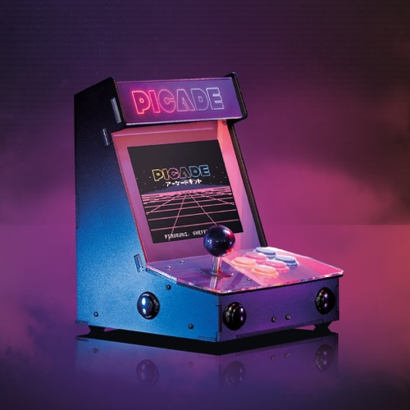
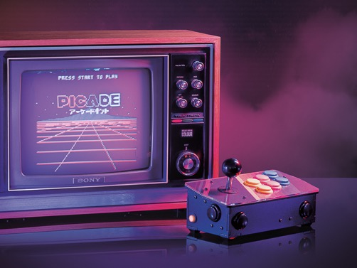
Picade
There are several excellent kits.
Two of the best are:
Picade Console
Picade Cabinet
http://thepihut.com

Slide 16

Operating System + RetroPie
RetroPie allows you to turn your Raspberry Pi into a retro-gaming machine.
It builds upon Raspbian and enables you to play your favorite Arcade, home-console, and classic PC games with the minimum set-up.
https://retropie.org.uk

Slide 17
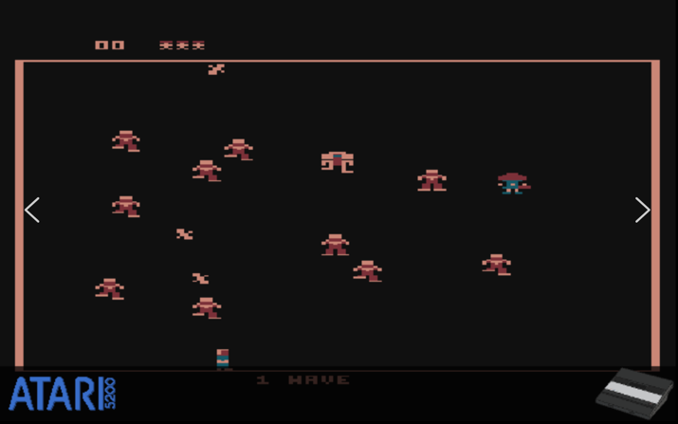
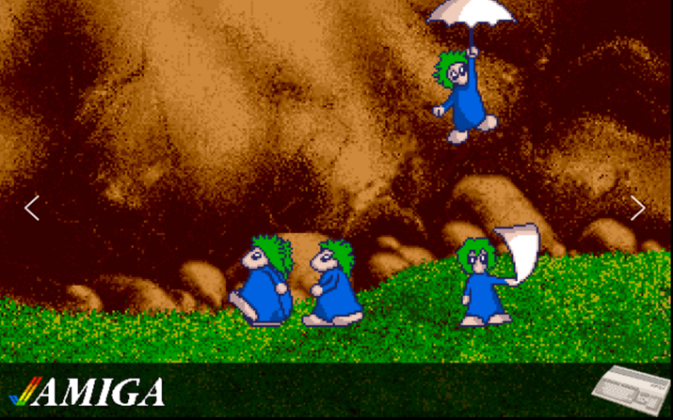
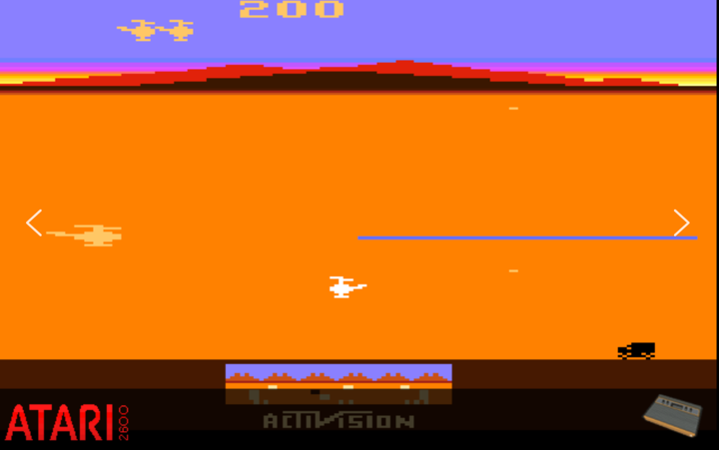
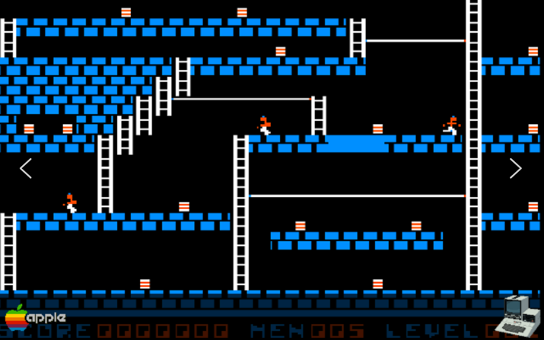
RetroPie Emulations

Slide 18
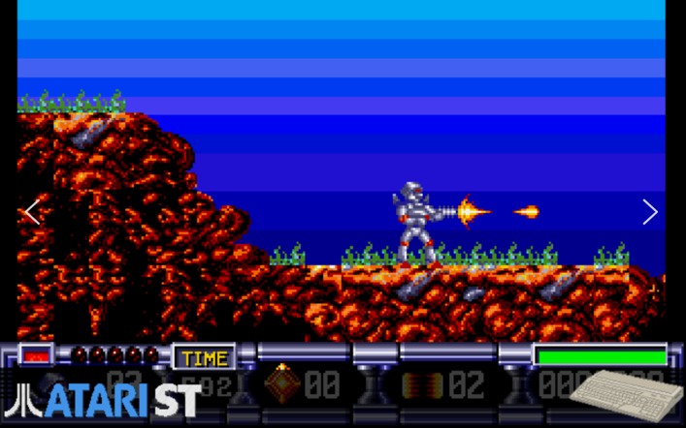
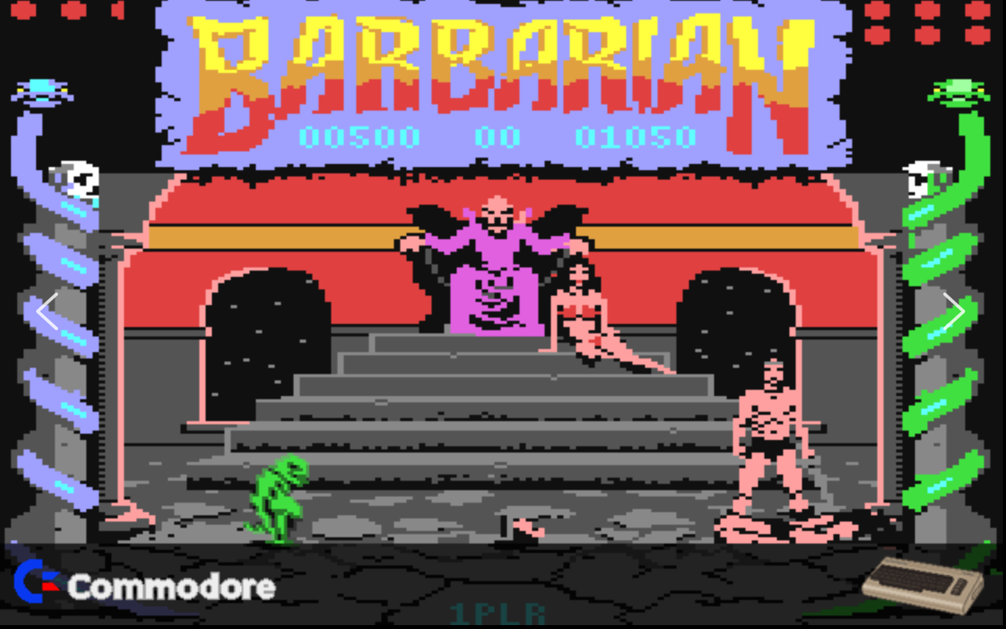
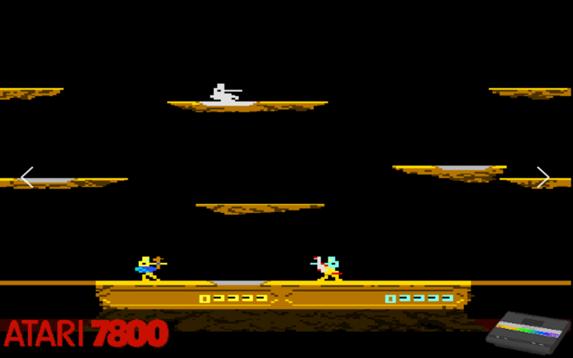
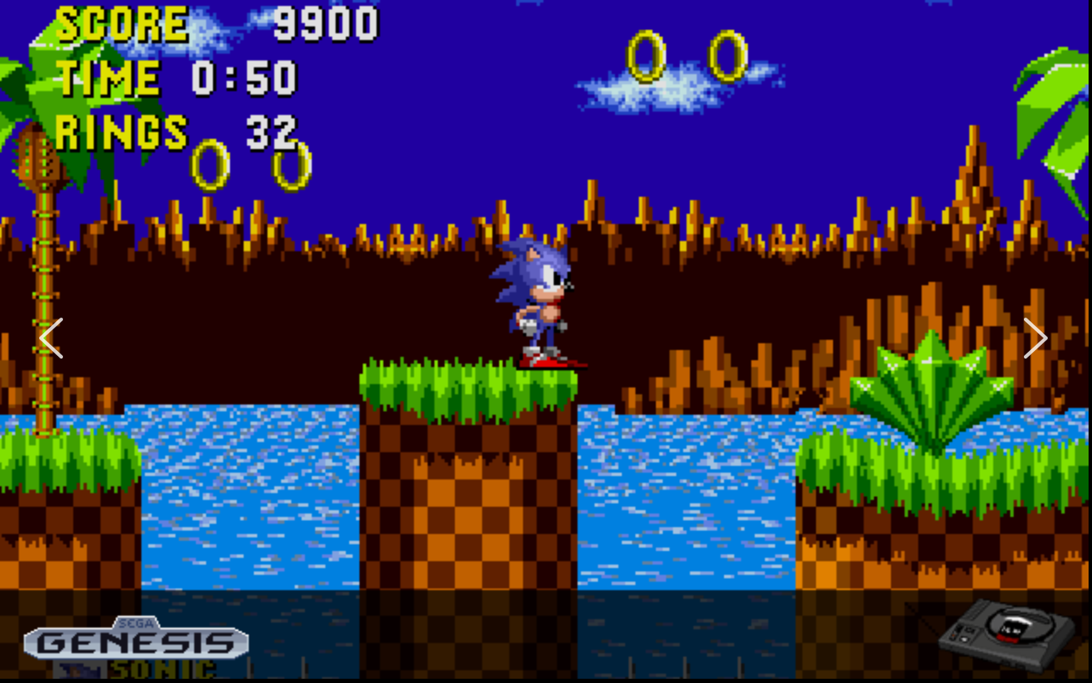
RetroPie Emulations

Slide 19
Hacking Minecraft with Python
Let’s build some games!

Slide 20
The TNT Run! Game
You’re going to create another mini-game.
You’ll create a game called TNT Run, in which you start at one end of a long line of TNT and have to make it to the safe area without the TNT exploding in your face.
You win if you make it to the end before it explodes.
You loose if you get blown up!

Slide 21
TNT Run! Game Construction
We will use code to create a long line of TNT blocks starting from Steve’s position.
Find a good, flat area in the world to place the game.
Or, create a new world.
The line is a line of TNT blocks that Steve must run on.
At the end, we place a special block that teleports Steve away from the coming conflagration (explosion).
The idea is, you hit the first TNT block then run to the teleport site.
How do you make Steve run?
Touch the forward button twice and hold it down to sprint.
To return to normal speed, just let go of the forward button, then walk forward again with a single tap.

Slide 22
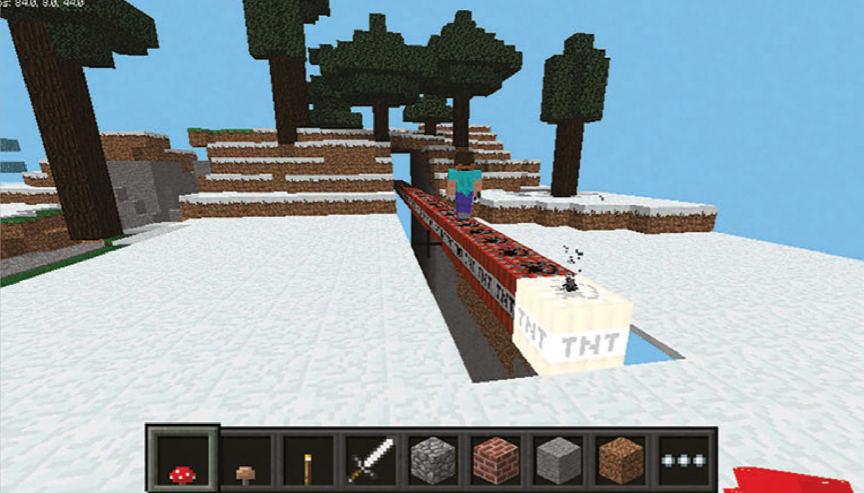
TNT Run!

Slide 23
The Code
# import all the necessary modules
from mcpi.minecraft import Minecraft
from mcpi import block
import time
# connect with the Minecraft world
mc = Minecraft.create()
# get the players position
pos = mc.player.getTilePos()
# check if the end of the world will engulf your TNT creation and will then move you if you are to close
if pos.z < -40:
mc.postToChat('Teleporting to safer distance in progress!')
mc.player.setPos(pos.x, pos.y, -40)
pos = mc.player.getTilePos()

Slide 24
The Code
# mark were the teleport is
zpos = pos.z - 40
# create the valley by hollowing it out with air
mc.setBlocks(pos.x - 1, pos.y + 3, pos.z,
pos.x + 1, pos.y - 7, pos.z - 88, block.AIR.id)
# build the bomb
mc.setBlocks(pos.x, pos.y, pos.z,
pos.x, pos.y, pos.z-88, block.TNT.id,1)
# build the end podium
mc.setBlocks(pos.x - 2, pos.y, pos.z - 93,
pos.x + 2, pos.y, pos.z - 97, block.GLOWING_OBSIDIAN.id)
mc.setBlocks(pos.x - 1, pos.y + 1, pos.z - 94,
pos.x + 1, pos.y + 1, pos.z - 96, block.NETHER_REACTOR_CORE.id,1)
mc.setBlock(pos.x, pos.y + 2, pos.z - 95, block.REDSTONE_ORE.id)

Slide 25
The Code
# build the invisible bedrock support
mc.setBlocks(pos.x, pos.y - 1, pos.z,
pos.x, pos.y - 7, pos.z, block.BEDROCK_INVISIBLE.id)
mc.setBlocks(pos.x - 1, pos.y - 1, pos.z,
pos.x, pos.y - 7, pos.z, block.BEDROCK_INVISIBLE.id)
mc.setBlocks(pos.x + 1, pos.y - 1, pos.z,
pos.x, pos.y - 7, pos.z, block.BEDROCK_INVISIBLE.id)
mc.setBlocks(pos.x, pos.y - 1, pos.z - 88,
pos.x-1, pos.y - 7, pos.z - 88, block.BEDROCK_INVISIBLE.id)
mc.setBlocks(pos.x - 1, pos.y - 1, pos.z - 88,
pos.x, pos.y - 7,pos.z - 88, block.BEDROCK_INVISIBLE.id)
mc.setBlocks(pos.x + 1, pos.y - 1, pos.z - 88,
pos.x, pos.y - 7, pos.z - 88, block.BEDROCK_INVISIBLE.id)
mc.setBlocks(pos.x, pos.y, pos.z,
pos.x, pos.y - 7, pos.z-92, block.BEDROCK_INVISIBLE.id)

Slide 26
The Code
# setting how many teleports you have
teleport = 1
# build the display teleport signal block
mc.setBlock(pos.x + 1, pos.y + 1, pos.z - 44, block.NETHER_REACTOR_CORE.id,2)
mc.setBlock(pos.x - 1, pos.y + 1, pos.z - 44, block.NETHER_REACTOR_CORE.id,2)
# teleport player when at a certain position
while teleport == 1:
pos = mc.player.getTilePos()
if pos.z == zpos:
mc.player.setPos(pos.x, pos.y, pos.z-24)
teleport = 0

Slide 27
The TNT Run! Game
Now, you try playing the game for a few minutes.
Connect to the Internet and update the git repo:
Open a terminal
cd Documents/Mines-Minerals-and-Minecraft
git pull
Open and run the code named tntrun.py.
Find a nice, level area to start the game.
Warning: it’s not easy!

Slide 28
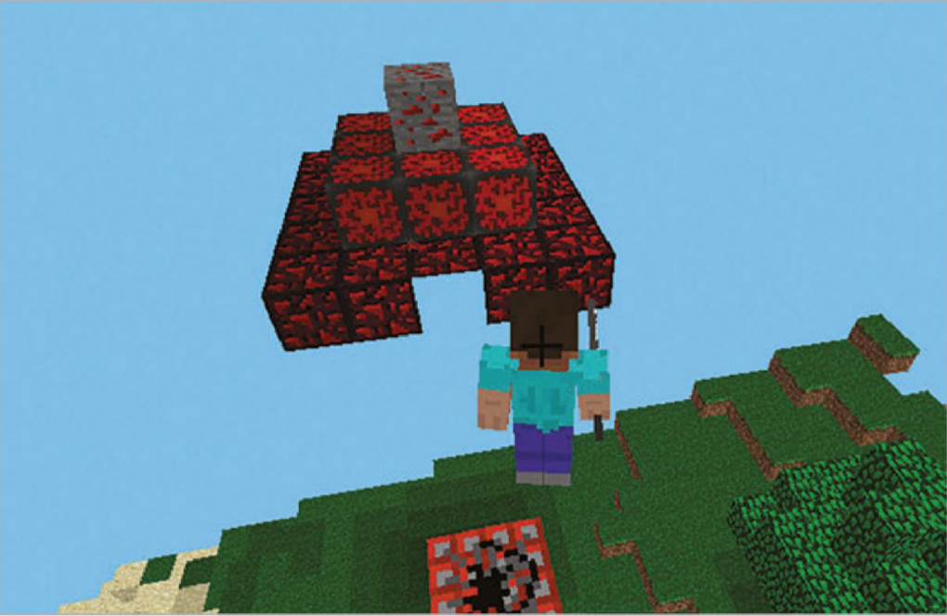
The TNT Run! Game

Slide 29
Next Steps
Modifications:
Make the row of TNT longer
Create a fancier safe area
When you’re connected to a network with other Raspberry Pis, you can join someone else’s world, create two lines of TNT and race to the safe areas simultaneously!

Slide 30
LAB TIME
Use the remainder of class to explore The TNT Run! Game.
You can leave when you’re finished.
DO NOT DISTURB the other classes!
REMEMBER TO SHUTDOWN YOUR RASPBERRY PI
DO NOT POWER IT OFF UNTIL YOU SHUTDOWN

Slide 31
Questions or comments?

